Slide 1
Assembly Language

Slide 2
Introduction
A computer system includes both hardware and software. The designer should be familiar with both of them.
This chapter introduces some basic programming concepts and shows their relation to the hardware representation of instructions.
A program may be : dependent or independent on the computer that runs it.

Slide 3
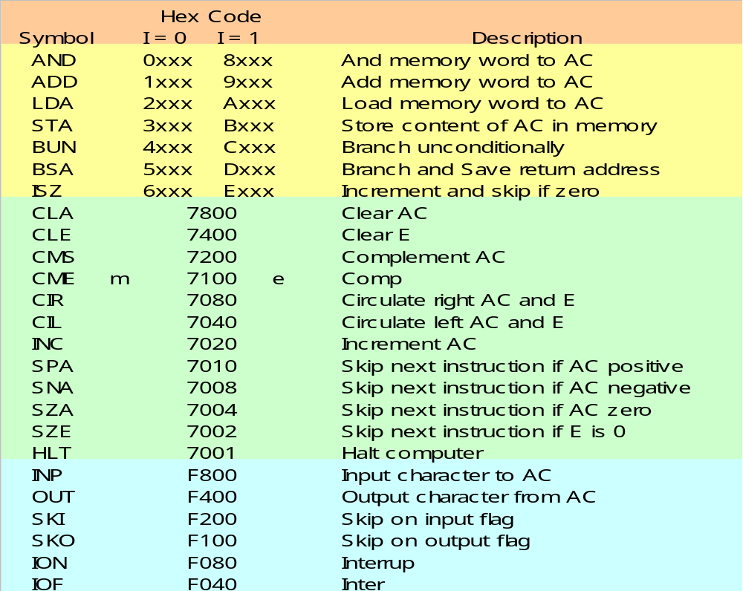
Basic instruction codes

Slide 4
Machine Language
Program: A list of instructions that direct the computer to perform a data processing task.
Many programming languages (C++, JAVA). However, the computer executes programs when they are represented internally in binary form.
Binary code: a binary representation of instructions and operands as they appear in computer memory.
Octal or hexadecimal code: translation of binary code to octal or hexadecimal representation.

Slide 5
Hierarchy of programming languages
The user uses symbols (Letter, numerals, or special characters) for the operation, address and other parts of the instruction code (Symbolic code).
symbolic code → binary coded instruction
The translation is done by a special program called an assembler
High-level programming language:
C++ : used to write procedures to solve a problem or implement a task.
Assembly language: concerned with the computer hardware behavior.

Slide 6
Binary/Hex Code
Binary Program to Add Two Numbers:
Location Instruction Code
Location Instruction
0 0010 0000 0000 0100
1 0001 0000 0000 0101
10 0011 0000 0000 0110
11 0111 0000 0000 0001
100 0000 0000 0101 0011
101 1111 1111 1110 1001
110 0000 0000 0000 0000
Binary code
000 2004
001 1005
002 3006
003 7001
004 0053
005 FFE9
006 0000
Hexadecimal code
It is hard to understand the task of the program ➔ symbolic code

Slide 7
Symbolic OP-Code
Location Instruction Comments
000 LDA 004 Load 1st operand into AC
001 ADD 005 Add 2nd operand to AC
002 STA 006 Store sum in location 006
003 HLT Halt computer
004 0053 1st operand
005 FFE9 2nd operand (negative)
006 0000 Store sum here
Symbolic names of instructions instead of binary or hexadecimal code.
The address part of memory-reference and operands ➔ remain hexadecimal.
Symbolic programs are easier to handle.

Slide 8
Assembly language: the basic unit of an assembly language program is a line of code . The specific language by a set of rules that specifies the symbols that can be used and how they may be combined to form a line of code.
Rules for the language :
- label : may be empty or it may specify a symbolic address
- instruction : specifies a machine instruction or a pseudo instruction
Comment : may be empty or it may be include a comment

Slide 9
Assembly Language
Assembly language programs are written using statements with three fields
  Label :: A symbolic address - a string delimited by a comma ‘,’
  Instruction :: either a machine instruction or a pseudo-instruction
  Comment :: Programmer comments not relevant to program logic
Label Instruction Comment
ORG 0 /Pseudo-instruction
LDA A /Machine instruction, symbol reference
ADD B /Machine instruction, symbol reference
STA C /Machine instruction, symbol reference
HLT /Machine instruction
A, DEC 83 /Pseudo-instruction with label field
B, DEC -23 /Pseudo-instruction with label field
C, DEC 0 /Pseudo-instruction with label field
END /Pseudo-instruction

Slide 10
Assembly Language – Symbolic Addresses
Symbolic addresses, or Labels,
  Consist of strings delimited by a comma ‘,’ !
  Consist of 1, 2 or 3 characters only !(not more than three characters)
  The first character must be letter next two can be character/ numerals
  May be preceded by white spaces.
Label Instruction Comment
ORG 0 /Pseudo-instruction
LDA A /Machine instruction, symbol reference
ADD BB /Machine instruction, symbol reference
STA CCC /Machine instruction, symbol reference
HLT /Machine instruction
A, DEC 83 /Pseudo-instruction with label field
BB, DEC -23 /Pseudo-instruction with label field
CCC, DEC 0 /Pseudo-instruction with label field
END /Pseudo-instruction

Slide 11
Assembly Language – Comments
Comments
  Begin with a slash ‘/’ character !
  All characters after the slash are part of the comment
  Comments are terminated by the new line character(s) !
  May be preceded by white spaces.
Label Instruction Comment
ORG 0 /Pseudo-instruction
LDA A /Machine instruction, symbol reference
ADD B /Machine instruction, symbol reference
STA C /Machine instruction, symbol reference
HLT /Machine instruction
A, DEC 83 /Pseudo-instruction with label field
B, DEC -23 /Pseudo-instruction with label field
C, DEC 0 /Pseudo-instruction with label field
END /Pseudo-instruction

Slide 12
Assembly Language – Instructions (0)
There are three types of Instructions
  Memory Reference Instructions (MRI)
  Non-Memory Reference Instructions (non-MRI)
    Register reference
    Input/Output reference
  Pseudo-Instructions (soo-do, or syu-do)
Label Instruction Comment
ORG 0 /Pseudo-instruction
LDA A /Machine instruction, symbol reference
ADD B /Machine instruction, symbol reference
STA C /Machine instruction, symbol reference
HLT /Machine instruction
A, DEC 83 /Pseudo-instruction with label field
B, DEC -23 /Pseudo-instruction with label field
C, DEC 0 /Pseudo-instruction with label field
END /Pseudo-instruction

Slide 13
Assembly Language – Instructions (1)
Memory Reference Instructions (MRI)
  Have an address operand
    Symbolic address label
    Decimal number
  Occupies 2/3 symbols separated by spaces
  First must be three letter symbol defining MRI code
  second is a symbolic address and third symbol ‘I’ , presence of I means indirect address and absence direct address
  Instructions are terminated by either a comment, or a new line char.
AND, ADD, LDA, STA, BUN, BSA, ISZ
Label Instruction Comment
ORG 0 /Pseudo-instruction
LDA A /Machine instruction, symbol reference
ADD B /Machine instruction, symbol reference
STA C /Machine instruction, symbol reference
HLT /Machine instruction
A, DEC 83 /Pseudo-instruction with label field
B, DEC -23 /Pseudo-instruction with label field
C, DEC 0 /Pseudo-instruction with label field
END /Pseudo-instruction

Slide 14
Assembly Language – Instructions (2)
Non-Memory Reference Instructions (non-MRI)
  Do not have any address part
    Implicitly specify the register operand(s)
  Two kinds of instructions:
    Register reference
    Input/Output reference
CLA, CLE, CMA, CME, CIR, CIL, INC, SPA, SNA, SZA, SZE, HLT
INP, OUT, SKI, SKO, ION, IOF
Label Instruction Comment
ORG 0 /Pseudo-instruction
LDA A /Machine instruction, symbol reference
ADD B /Machine instruction, symbol reference
STA C /Machine instruction, symbol reference
HLT /Machine instruction
A, DEC 83 /Pseudo-instruction with label field
B, DEC -23 /Pseudo-instruction with label field
C, DEC 0 /Pseudo-instruction with label field
END /Pseudo-instruction

Slide 15
Assembly Language – Instructions (3)
Pseudo-Instructions
  Provide directions to the Assembler for translating the program or instruction
  Four instructions:
    ORG n – Set the Assembler memory Location Counter (LC = n)
    END – Denote the end of the Assembly Language program
    DEC – Specify a value in decimal number to be converted into binary
    HEX – Specify a value in hexadecimal number to be converted into binary
Label Instruction Comment
ORG 0 /Pseudo-instruction
LDA A /Machine instruction, symbol reference
ADD B /Machine instruction, symbol reference
STA C /Machine instruction, symbol reference
HLT /Machine instruction
A, DEC 83 /Pseudo-instruction with label field
B, DEC -23 /Pseudo-instruction with label field
C, DEC 0 /Pseudo-instruction with label field
END /Pseudo-instruction

Slide 16
Example : subtraction
Assembly language program to subtract two numbers
 | ORG 100 | /Origin of program is location 100
 | LDA SUB | /Load subtrahend to AC
 | CMA | /Complement AC
 | INC | /Increment AC
 | ADD MIN | /Add minuend to AC
 | STA DIF | /Store difference
 | HLT | /Halt computer
MIN, | DEC 83 | /Minuend
SUB, | DEC -23 | /Subtrahend
DIF, | HEX 0 | /Difference store here
 | END | /End of the symbolic program

Slide 17
Location Referencing
In order to correctly translate a symbolic address reference, it is necessary to how where the symbol is defined within the program
A special memory location counter (LC, or MLC) is defined within the Assembler program.
  Default initial value :: LC = 0
  Set value to specified location :: ORG n ( LC = n )
  Default Modification
    For each machine instruction and DEC/HEX pseudo-instruction,
    LC = LC + 1

Slide 18
Symbolic Address Resolution
Memory reference instructions usually reference memory locations symbolically (eg. variable name)
Programmers may define the symbol name
  Earlier than the reference in an instruction
  Later than the reference in an instruction
PROBLEM:
Cannot translate a symbol unless its location is known.
Label Instruction Comment
ORG 0 /Pseudo-instr
BUN H /Machine instr, symbol reference
C, HEX 0 /Pseudo-instr
H, LDA A /Machine instr, symbol reference
ADD B /Machine instr, symbol reference
STA C /Machine instr, symbol reference
HLT /Machine instr
A, DEC 83 /Pseudo-instr
B, DEC -23 /Pseudo-instr
END /Pseudo-instr
SOLUTION:
Use a Symbol Table to record symbol definitions and References.
Need to pass through program twice in order to resolve all symbolic addresses.

Slide 19
=> Representation of symbolic program in memory
- A loader program is used to input the characters of symbolic program into memory.
Since the program consists of symbols, its representation in memory must use an alphanumeric characters and each character is represented in 8- bit code.
The high order bit is always zero and other seven bits are specified by ASCII

Slide 20
Hexadecimal character code
Hexadecimal character code
Character | Code | Character | Code | Character | Code | Character | Code
A | 41 | O | 4F | 2 | 32 | - | 2D
B | 42 | P | 50 | 3 | 33 | . | 2E
C | 43 | Q | 51 | 4 | 34 | / | 2F
D | 44 | R | 52 | 5 | 35 | = | 3D
E | 45 | S | 53 | 6 | 36 | CR | 0D
F | 46 | T | 54 | 7 | 37
G | 47 | U | 55 | 8 | 38
H | 48 | V | 56 | 9 | 39
I | 49 | W | 57 | Space | 20
J | 4A | X | 58 | ( | 28
K | 4B | Y | 59 | ) | 29
L | 4C | Z | 5A | * | 2A
M | 4D | 0 | 30 | + | 2B
N | 4E | 1 | 31 | ‘ | 2C

Slide 21
Example: Translation into binary
Hexadecimal code
Location | Content | Symbolic program
 |  |  | ORG 100
100 | 2107 |  | LDA SUB
101 | 7200 |  | CMA
102 | 7020 |  | INC
103 | 1106 |  | ADD MIN
104 | 3108 |  | STA DIF
105 | 7001 |  | HLT
106 | 0053 | MIN, | DEC 83
107 | FFE9 | SUB, | DEC -83
108 | 0000 | DIF, | HEX 0
 |  |  | END

Slide 22
Memory Word | Symbol | Hexadecimal Code | Binary Representation
1 | P L | 50 4C | 0101 0000 0100 1100
2 | 3 , | 33 2C | 0011 0011 0010 1100
3 | L D | 4C 44 | 0100 1100 0100 0100
4 | A | 20 | 0100 0001 0010 0000
5 | S U | 55 | 0101 0011 0101 0101
6 | B | 42 20 | 0100 0010 0010 0000
7 | I CR | 49 0D | 0100 1001 0000 1101

Slide 23
Assembler Flowchart
Assembler requirements:
  Location Counter (LC)
  Symbol Table
  Recognition of OpCodes
  Recognition of Pseudo-Instructions
  Recognition of Comments
  Detection and Definition of User-Defined Symbolic Addresses
  Detection and Resolution of User-Defined Symbolic Address References
  Multiple passes through program source code
  Production of Object Code (ie. machine code)

Slide 24
A two pass assembler scans the complete program twice .
During first pass it generate a table that correlates all user defined address symbols with their binary equivalent.
The binary translation is done during the second pass.
To keep track of the location of instruction the assembler uses a memory word called location counter(LC).
The content of the LC stores the value of the memory location assigned to the instruction or operand presently being processed.

Slide 25
The ORG pseudo instruction initializes the location counter to the value of the first location and value of LC will be incremented by 1 i-e LC+1
To avoid the ambiguity in case of ORG is missing , the assembler sets the location counter to 0 initially .

Slide 26
Working of assembler : PASS I
LC is initially set to 0
A Line of symbolic code is analyzed to determine if it has a label
If there is no label the assembler checks the symbol in the instruction field.
If it contains ORG pseudo instruction, the assembler set LC to the number that follows ORG and goes back to process the next line

Slide 27
Assembler Flowchart – Pass 1
First pass
LC = 0
Scan next line of code
Set LC
yes
Label
no
ORG
Symbol Table
LABEL1 LC1
LABELn LCn
…
yes
no
Store symbol in Symbol Table together with value of LC
END
no
yes
Must be a machine, DEC or HEX instruction
LC = LC + 1
Go to second pass

Slide 28
Working of assembler: Pass II
Machine instructions are translated during pass II by means of of table loop up procedures.
A table look up procedure is a search of table entries to determine whether a specific item matches one of the item stored in the table or not.
In pass II the assembler uses 4 tables:
- Pseudo instruction table:
The pseudo instruction table vales for 4 symbols :
ORG:
END:
DEC :
HEX:
- MRI table : contains 7 symbols of MRI instructions and their 3 bit operation code equivalent.
- Non MRI table : contains 18 symbols for register reference and input output instructions and their 16 bit binary equivalent .
- Address symbol table: is generated during first pass. The assembler searches these table to find the symbol that it is currently processed in order to determine its bnary value.

Slide 29
Assembler Flowchart – Pass 2
Second pass
LC = 0
Done
Scan next line of code
Set LC
yes
yes
Pseudo
yes
ORG
no
END
no
no
DEC/HEX
LC = LC + 1
MRI
no
nonMRI
no
Convert operand to binary and store at location LC
yes
yes
Translate instruction components, compile to binary and store at location LC
Store binary translation of instruction at location LC
Error in code

Slide 30
Assembler Flowchart – Pass 2
Second pass
LC = 0
Done
Scan next line of code
Set LC
yes
yes
Pseudo
yes
ORG
no
END
no
no
LC = LC + 1
MRI
no
nonMRI
no
Convert operand to binary and store at location LC
yes
yes
Translate instruction components, compile to binary and store at location LC
Store binary translation of instruction at location LC
Error in code

Slide 31
Assembler Flowchart – Pass 2 (MRI)
Translate instruction components, compile to binary and store at location LC
Parse OpMnemonic and convert to binary, set bits 12-14
Parse operand symbol, search Symbol Table and convert LC value to bits 0-11
yes
I
no
Set bit 15 to 1
Set bit 15 to 0
Assemble all parts of instruction translation and store at location LC

